Slide 1

Piko: A Framework for Authoring Programmable Graphics Pipelines
Anjul Patney and Stanley Tzeng
UC Davis and NVIDIA
Kerry A. Seitz, Jr. and John D. Owens
UC Davis

Slide 2
What does an efficient graphics pipeline look like?

Slide 3
What does an efficient graphics pipeline look like?
Renderer
Unreal Engine 4
Unity 5
Disney Hyperion
Pixar RenderMan
Solid Angle Arnold
Media Molecule Dreams

Slide 4
What does an efficient graphics pipeline look like?
Renderer | Platform
Unreal Engine 4 | GPU
Unity 5 | GPU
Disney Hyperion | Multicore CPU
Pixar RenderMan | Multicore CPU
Solid Angle Arnold | Multicore CPU
Media Molecule Dreams | GPU

Slide 5
What does an efficient graphics pipeline look like?
Renderer | Platform | Algorithm
Unreal Engine 4 | GPU | Rasterization with deferred shading
Unity 5 | GPU | Rasterization with forward / deferred shading
Disney Hyperion | Multicore CPU | Path tracing with deferred shading
Pixar RenderMan | Multicore CPU | Reyes with Path tracing
Solid Angle Arnold | Multicore CPU | Path tracing
Media Molecule Dreams | GPU | Point-based rendering with deferred shading

Slide 6
Problem
Efficient graphics pipeline implementations are hard to write and the design space is hard to explore.

Slide 7
Vision
Flexibility
Stage A
CPU
Stage B
Stage E
?
Stage C
Stage D
GPU
Stage F
High-performance
High-level programmability

Slide 8
Existing Work

Slide 9
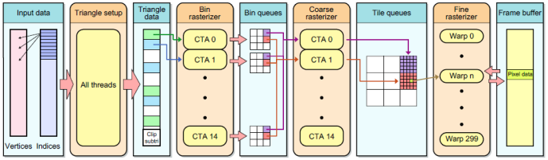
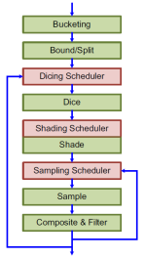
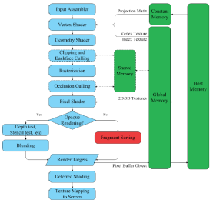
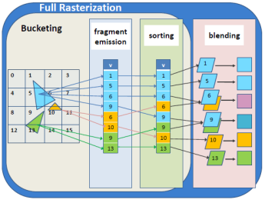
Software Pipelines on GPUs
CudaRaster
RenderAnts
FreePipe
VoxelPipe
OptiX and Embree
Programmable engines for accelerating ray tracing on specific platforms.

Slide 10
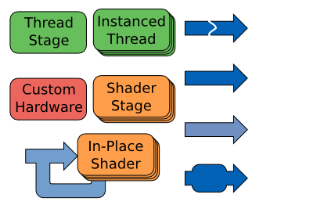
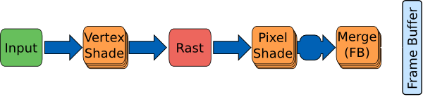
GRAMPS
Introduces flexible graphics pipelines
Abstracts stages in classes
Abstracts communication by queues
[Sugerman et al. 2009]

Slide 11
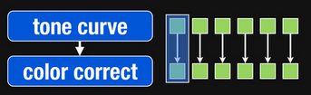


Halide
Introduces programmable image pipelines
Applies well to shorter and more regular image-processing pipeline
[Ragan-Kelley et al. 2012]

Slide 12
What are the fundamentals of high-performance?
Parallelism
Execution Locality
Data Locality
Producer-consumer locality
Spatial tiling

Slide 13



Efficient graphics pipelines utilize spatial tiling

Slide 14
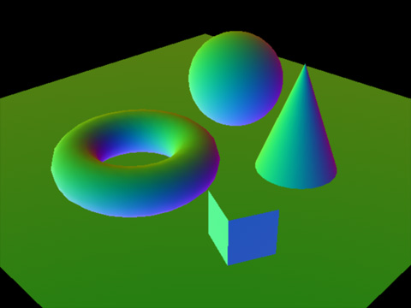
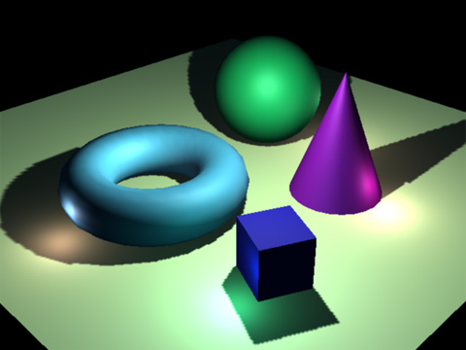
Efficient graphics pipelines utilize spatial tiling

Slide 15
Efficient graphics pipelines utilize spatial tiling
Packet ray tracing
SIMD fragment shading on GPUs
Tiled rendering on mobile GPUs

Slide 16
Vision
Flexibility
Stage A
CPU
Stage B
Stage E
?
Stage C
Stage D
GPU
Stage F
High-performance
High-level programmability

Slide 17
Vision
Flexibility
Stage A
CPU
Stage B
Stage E
Piko
Stage C
Stage D
GPU
Stage F
High-performance
High-level programmability

Slide 18
System Walkthrough

Slide 19
CPU Compiler
Host Code
(C++)
Host Interface (C++)
pikoc
Executable
Pipe Description
(Piko)
Device Compiler
Pipe Implementation
(C++ / PTX)

Slide 20
CPU Compiler
Device-independent
(C++)
Host Code
(C++)
Host Interface (C++)
pikoc
Executable
Pipe Description
(Piko)
Device Compiler
Pipe Implementation
(C++ / PTX)

Slide 21
CPU Compiler
Host Code
(C++)
Host Interface (C++)
pikoc
Executable
Pipe Description
(Piko)
Device Compiler
Pipeline description (graph of stages)
Pipe Implementation
(C++ / PTX)

Slide 22
CPU Compiler
Host Code
(C++)
Host Interface (C++)
pikoc
Executable
Pipe Description
(Piko)
Device Compiler
Pipe Implementation
(C++ / PTX)
Clang- and LLVM- based infrastructure

Slide 23
CPU Compiler
Host Code
(C++)
Host Interface (C++)
pikoc
Executable
Pipe Description
(Piko)
Device Compiler
Pipe Implementation
(C++ / PTX)

Slide 24
Problem
Efficient graphics pipeline implementations are hard to write and the design space is hard to explore.

Slide 25
Problem
Efficient graphics pipeline implementations are hard to write and the design space is hard to explore.
Approach
Use spatial tiling to help author efficient and flexible graphics pipelines.

Slide 26
Problem
Efficient graphics pipeline implementations are hard to write and the design space is hard to explore.
Approach
Use programmable spatial tiling to help author efficient and flexible graphics pipelines.

Slide 27
Programmable Spatial Tiling

Slide 28
We need three answers from the pipeline author
How does data map to spatial tile?
How do we schedule tiles at runtime?
What to compute for each tile?
AssignTile( )
Schedule( )
Process( )
Each stage consists of these three “phases”

Slide 29
Each stage in a pipeline has three phases
AssignTile
Schedule
Stage A
Process
AssignTile
Stage B
Schedule
Process
Stage C
AssignTile
Schedule
Process

Slide 31
AssignTile

Slide 32
AssignTile

Slide 33
AssignTile

Slide 34
AssignTile

Slide 35
Phases help identify optimization opportunities.
Stage A
Identical tile size
Stage B
Identical data-to-tile mapping
Stage C
Identical tile-to-core mapping
Stage D

Slide 36
Phases help identify optimization opportunities.
Stage A
Identical tile size
Stage B
Identical AssignTile Result
Stage B
Stage C
Stage C
Identical Schedule Result
➔ Stages can be fused to one
Stage D

Slide 37
Phases help explore pipeline implementations
Vertex Shade
VS
VS
VS
VS
Geometry Shade
GS
GS
GS
GS
Raster
Rst
Rst
Rst
Rst
Fragment Shade
FS
FS
FS
FS
Composite
Cmp
Cmp
Cmp
Cmp

Slide 38
Phases help explore pipeline implementations
Vertex Shade
VS
VS
VS
VS
Geometry Shade
GS
GS
GS
GS
Raster
Rst
Rst
Rst
Rst
Fragment Shade
FS
FS
FS
FS
Composite
Cmp
Cmp
Cmp
Cmp

Slide 39
Phases help explore pipeline implementations
Vertex Shade
VS
VS
VS
VS
Geometry Shade
GS
GS
GS
GS
Raster
Rst
Rst
Rst
Rst
Fragment Shade
FS
FS
FS
FS
Composite
Cmp
Cmp
Cmp
Cmp

Slide 40
Phases help explore pipeline implementations
Vertex Shade
VS
VS
VS
VS
Geometry Shade
GS
GS
GS
GS
Raster
Rst
Rst
Rst
Rst
Fragment Shade
FS
FS
FS
FS
Composite
Cmp
Cmp
Cmp
Cmp

Slide 41
Evaluation

Slide 42

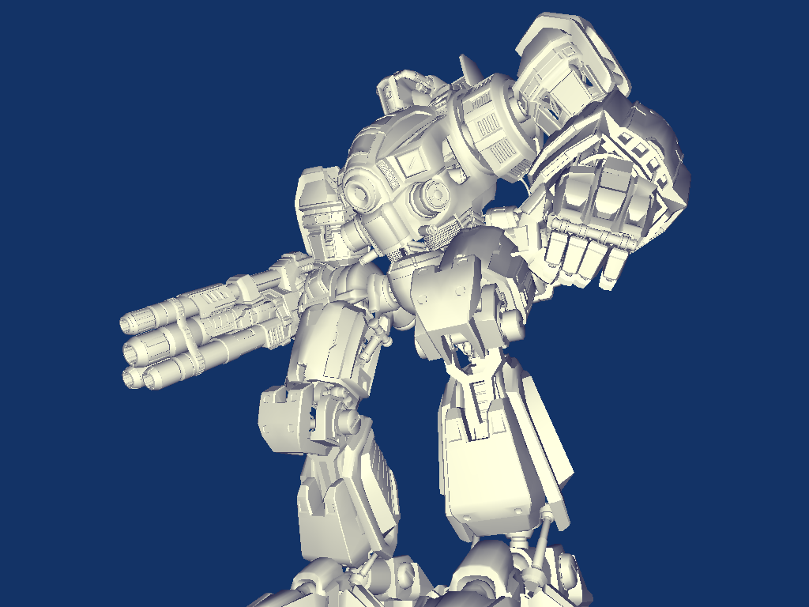
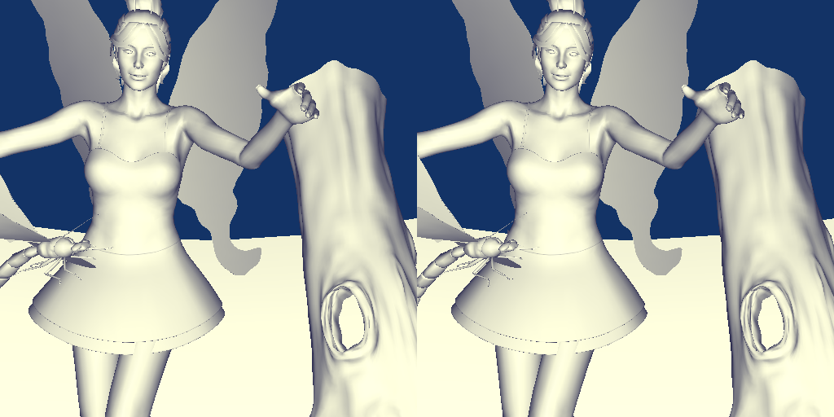

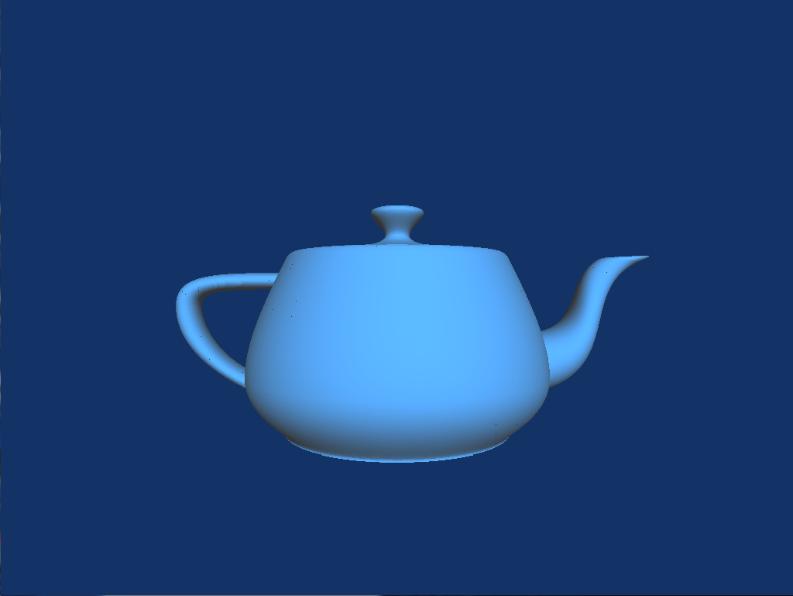

Piko pipelines are easy to express and customize
Triangle Raster
Stereo Raster
Reyes
Raster-Raytrace
VS
VS
Split
VS
Setup
Setup
Dice
Setup
Rast
Rast
Shade
Rast
FS
FS
FS
Sample
FS
Trace
Comp
Comp
Comp
Comp
Comp

Slide 43
Piko pipelines are easy to express and customize
Triangle Raster
Stereo Raster
Reyes
Raster-Raytrace
VS
VS
Split
VS
Setup
Setup
Dice
Setup
Rast
Rast
Shade
Rast
FS
FS
FS
Sample
FS
Trace
Comp
Comp
Comp
Comp
Comp

Slide 44
Piko pipelines are easy to express and customize
Triangle Raster
Stereo Raster
Reyes
Raster-Raytrace
VS
VS
Split
VS
Setup
Setup
Dice
Setup
Rast
Rast
Shade
Rast
FS
FS
FS
Sample
FS
Trace
Comp
Comp
Comp
Comp
Comp

Slide 45
Piko pipelines are easy to express and customize
Triangle Raster
Stereo Raster
Reyes
Raster-Raytrace
VS
VS
Split
VS
Setup
Setup
Dice
Setup
Rast
Rast
Shade
Rast
FS
FS
FS
Sample
FS
Trace
Comp
Comp
Comp
Comp
Comp

Slide 46
Piko lets us explore implementation alternatives
No tiling, complete stage fusion
VS
Fairy Forest
VS
Setup
Rast
FS
Comp
Setup
Rast
FS
Comp
NVIDIA GPU
Multicore CPU
Baseline

Slide 47
Piko lets us explore implementation alternatives
Tiling with fusion
VS
Fairy Forest
VS
Setup
Setup
Rast
Rast
FS
Comp
FS
Comp
NVIDIA GPU
Multicore CPU
Baseline

Slide 48
Piko lets us explore implementation alternatives
Tiling with no fusion
VS
VS
Setup
Fairy Forest
Setup
Rast
Rast
FS
FS
Comp
Comp
NVIDIA GPU
Multicore CPU
Baseline

Slide 49
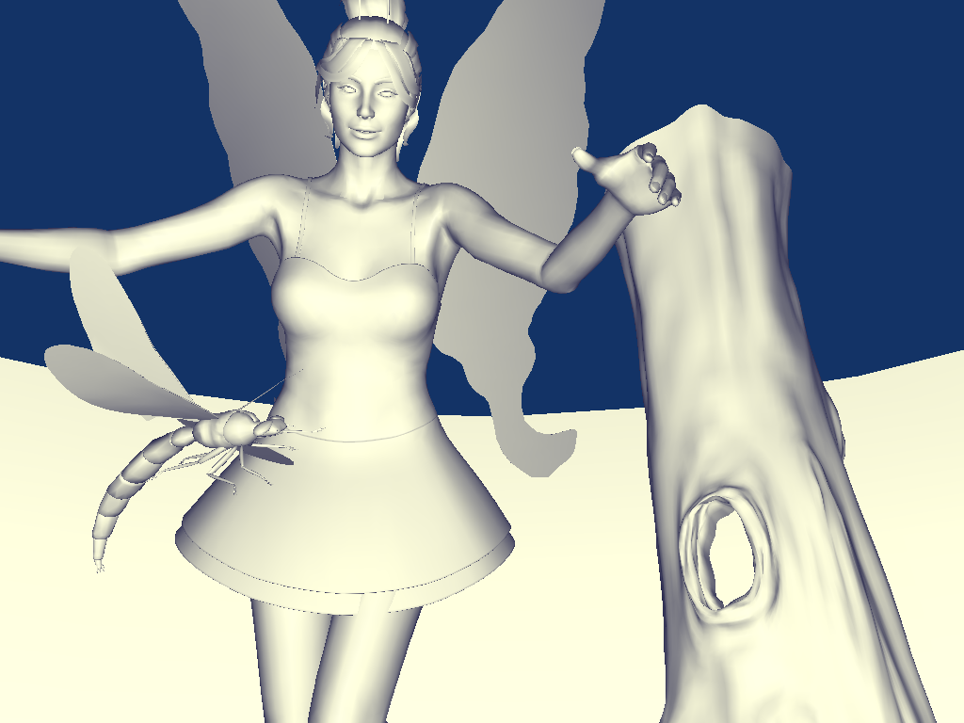
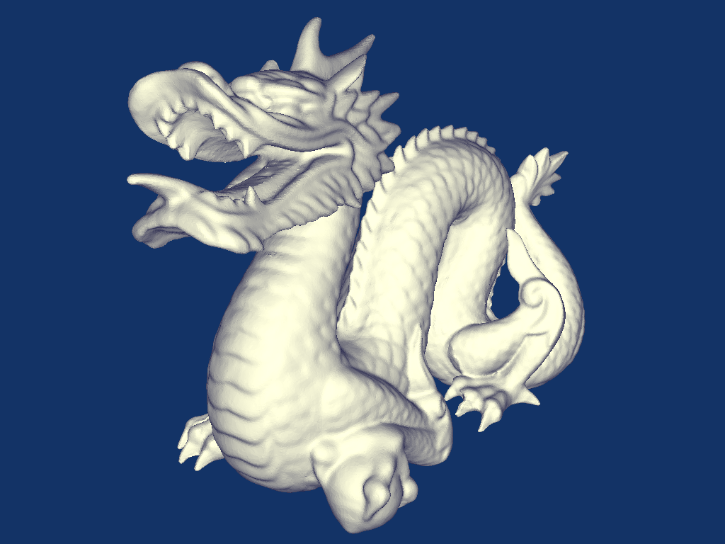
Piko enables high-performance code generation
Performance is within 3.3-5.5x of hand-optimized code.
[Laine and Karras 2011]

Slide 50
Piko enables high-performance code generation
Split performance is within 30% of hand-optimized GPU Reyes.
[Weber et al. 2015]

Slide 51
Summary

Slide 52
Piko enables programmability and performance
Stage A
CPU
Stage B
Stage E
Piko
Stage C
Stage D
GPU
Stage F

Slide 53
Piko enables programmability and performance
Stage A
CPU
Stage B
Stage E
Piko
Stage C
Stage D
GPU
Stage F
High-level programmability

Slide 54
Piko enables programmability and performance
Stage A
CPU
Stage B
Stage E
Piko
Stage C
Stage D
GPU
Stage F
High-performance

Slide 55
Piko enables programmability and performance
Stage A
CPU
Stage B
Stage E
Piko
Stage C
Stage D
GPU
Stage F
Flexibility

Slide 56
Our work is not done

Slide 57
Piko can be improved
Stage A
CPU
Stage B
Stage E
Piko
Stage C
Stage D
GPU
Stage F
Utilization of shared local memory

Slide 58
Piko can be improved
Stage A
CPU
Stage B
Stage E
Piko
Stage C
Stage D
GPU
Stage F
Support for dynamic scheduling of pipeline work

Slide 59
Piko can be improved
Stage A
CPU
Stage B
Stage E
Piko
Stage C
Stage D
GPU
Stage F
Support for more pipeline targets
SPIR-V
MPI

Slide 60
The search for a graphics abstraction is not over
Stage A
CPU
Stage B
Stage E
Piko
Stage C
Stage D
GPU
Stage F

Slide 61
The search for a graphics abstraction is not over
Stage A
CPU
Stage B
Stage E
Piko
Stage C
Stage D
GPU
Stage F
Do tiles have to be 2d, uniform, one-config-per stage?

Slide 62
The search for a graphics abstraction is not over
Stage A
CPU
Stage B
Stage E
Piko
Stage C
Stage D
GPU
Stage F
Are there other abstractions that enable high-level programmability and achieve high-performance?

Slide 63
The search for a graphics abstraction is not over
Stage A
CPU
Stage B
Stage E
Piko
Stage C
Stage D
GPU
Stage F
Are there richer abstractions graphics which don’t look like graphs of stages?

Slide 64
Acknowledgments
Discussions and advice
Tim Foley, Jonathan Ragan-Kelley, Aaron Lefohn, Matt Pharr, Mark Lacey, Kayvon Fatahalian, Bill Mark, Marco Salvi, Chuck Lingle, Jason Mak, Edmund Yan, Calina Copos, Mike Steffen, Alex Elkman
NVVM Help
Vinod Grover, Sean Lee
Financial Support
Intel Science and Technology Center (VC), NVIDIA Research Fellowship, Intel Ph.D. Fellowship, National Science Foundation Fellowship, NVIDIA, AMD, NSF, UC Lab Fees
Assets
AMD, Intel (Project Offset), Ingo Wald, Bay Raitt, Stanford

Slide 65
Thank you!
github.com/piko-dev/piko-public

Slide 66
Extra Slides

Slide 67
Host Code is device independent.
RasterPipe pipe;
pipe.allocate(...);
pipe.prepare();
pipe.run_single();
unsigned* pixels = pipe.pikoScreen.getData();
glDrawPixels(screenW, screenH, GL_RGBA, GL_UNSIGNED_BYTE, data);
Unmodified C++

Slide 68
A pipeline is a C++ class declaration.
class RasterPipe : public PikoPipe {
VertexShaderStage vertexShader_;
RasterStage raster_;
PikoScreen pikoScreen_;
...
RasterPipe() {
pikoConnect (vertexShader_, raster_, 0, 0);
}
...
};
Stages are instantiated as objects.
Connections indicate pipeline structure.

Slide 69
A stage is a C++ class definition.
class RasterStage : public Stage<8, 8, 32, raster_stri, Pixel> {
inline void AssignTile(raster_stri p) {
...
this->assignToBin (p, binID);
...
}
inline void schedule(int binID) {
this->specifySchedule (LOAD_BALANCE);
}
inline void process(raster_stri p)
{
...
this->emit (Pixel(pos, color), 0);
...
}
};
Templates specify tiling configuration.
Built-in routines identify common scenarios.
Each phase is a member function.

Slide 70
pikoc implements the pipeline description.
Pipeline
Pipe Implementation
pikoc
frontend
pikoc backend
Kernel
plan
clang
clang
libNVVM
Host Interface
Stages
Frontend walks the AST and performs high-level optimizations.
Backend uses LLVM to generate optimized device code.

Slide 71
WIP Slides

Slide 72
Efficient graphics pipelines utilize spatial tiling
Redo this diagram
Improved parallelism

Slide 73
Efficient graphics pipelines utilize spatial tiling
Redo this diagram
Improved locality

Slide 75

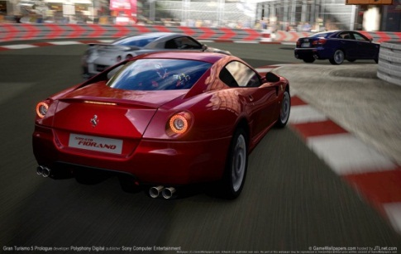
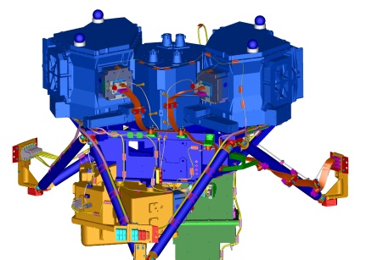

Piko
CPU
CPU
+
GPU
GPU

Slide 76
Graphics pipelines in the wild
Redshift??
GPU
Ray tracing
Disney Hyperion
Multicore CPU
Path Tracing
Sorted-Deferred Shading
Pixar Renderman
Multicore CPU
Reyes
Path tracing
RenderAnts
GPU
Reyes
Ray tracing
Solid Angle Arnold
Multicore CPU
Ray tracing
Unreal Engine 4
GPU
Rasterization with deferred shading
Temporal supersampling
Unity Engine
GPU
Rasterization
Forward / deferred shading

Slide 77
Piko pipelines are easy to express and customize
VS
VS
Split
VS
Setup
Setup
Dice
Setup
Rast
Rast
Shade
Rast
FS
FS
FS
Sample
Trace
Comp
Comp
Comp
Comp
FS
Comp
Raster
Stereo Raster
Reyes
Raster-Raytrace

Slide 78


Slide 79
Piko pipelines are easy to express and customize
Raster
Reyes
Stereo Raster
Raster-Raytrace

Slide 80
Piko pipelines are easy to express and customize
Fairy Forest
Buddha
NVIDIA GPU
Multicore CPU
No tiling, complete stage fusion

Slide 81
Piko pipelines are easy to express and customize
Fairy Forest
Buddha
NVIDIA GPU
Multicore CPU
Tiling with fusion

Slide 82
Piko pipelines are easy to express and customize
Fairy Forest
Buddha
NVIDIA GPU
Multicore CPU
Tiling with no fusion

Slide 83
Piko
Enables expressing graphics pipelines with clearly separated structure and function
Optimizes expressed pipelines to target different design scenarios and platforms
Allows redesign and retargeting without rewriting

Slide 84
Our work is not done
Several potential optimizations in the compiler
Shared memory use
Dynamic scheduling
Piko currently supports two targets
Potential support for MPI, SPIR-V

Slide 85
Phases help identify optimization opportunities.
Stage A
Identical tile size
Identical AssignTile Result
Identical Schedule Result
Stage B
Global Tile Sync

Slide 86
Phases help identify optimization opportunities.
Identical tile size
Stage A
Stage B
Identical AssignTile
Identical Schedule
Local Sync
Stages can be fused to one

Slide 87
Efficient graphics pipelines utilize spatial tiling

Slide 88
Efficient graphics pipelines utilize spatial tiling

Slide 89
Efficient graphics pipelines utilize spatial tiling

Slide 90
Efficient graphics pipelines utilize spatial tiling

